Slide 1

Long Short-Term Memory
Presented by:
Elizer Ponio Jr.
Department of Computer Science
College of Computing and Information Technologies

Slide 2
Outline
Introduction
RNN to LSTM to Transformers
Backpropagation Through Time
Limitations of RNN
Long Short-Term Memory

Slide 3
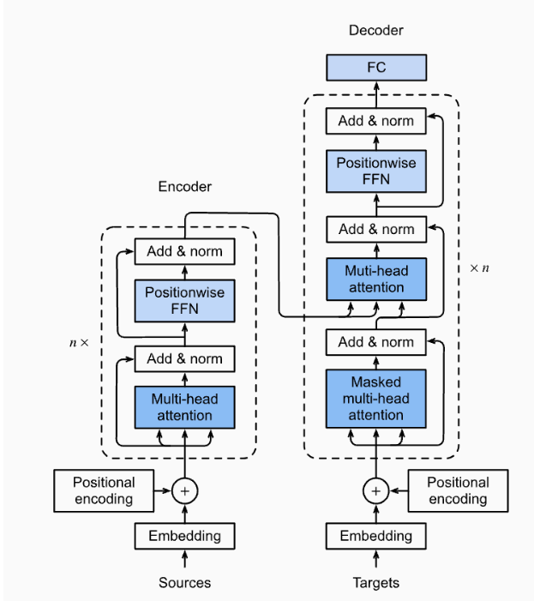
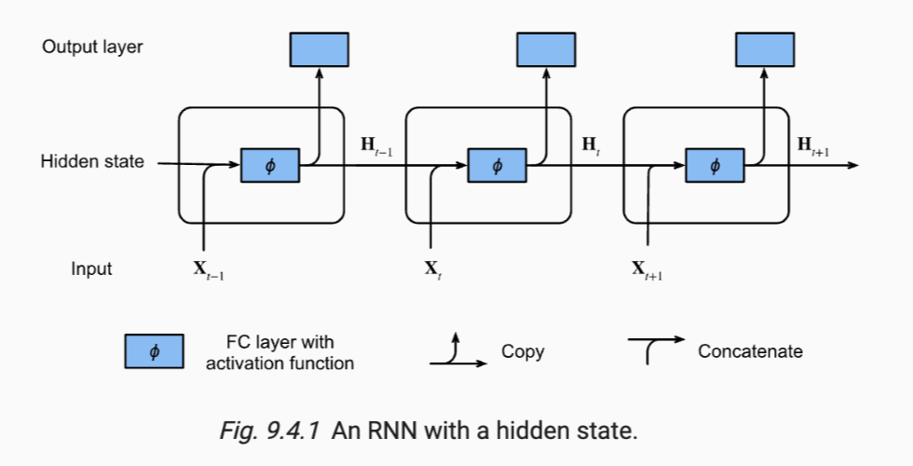
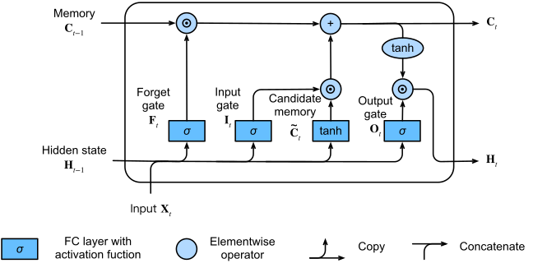
RNN to LSTM to Transformers
RNN
LSTM
Transformers
Throughout this lesson, we have covered RNNs and now LSTMs, which are stepping stones to learning about Transformers, which is the currently the state-of-the-art architecture

Slide 4

















Backpropagation Through Time
$$y_{t}$$
$$y_{t+1}$$
$$y_{t+2}$$
$$W_{y}$$
$$W_{y}$$
$$W_{y}$$
$$S_{t}$$
$$S_{t+1}$$
$$W_{s}$$
$$W_{s}$$
$$W_{s}$$
$$W_{x}$$
$$W_{x}$$
$$W_{x}$$
$$x_{t}$$
$$x_{t+1}$$
$$x_{t+2}$$

Slide 5



















Limitations of RNN (Vanishing and Exploding Gradient)
$$S_{1}$$
$$S_{2}$$
$$S_{3}$$
$$S_{4}$$
$$S_{5}$$
$$W_{s}$$
$$W_{s}$$
$$W_{s}$$
$$W_{s}$$
$$W_{x}$$
$$W_{x}$$
$$W_{x}$$
$$W_{x}$$
$$W_{x}$$
$$x_{1}$$
$$x_{2}$$
$$x_{3}$$
$$x_{4}$$
$$x_{5}$$

Slide 6





























Limitations of RNN
$$S_{1}$$
$$S_{2}$$
$$S_{3}$$
$$S_{4}$$
$$S_{5}$$
$$S_{6}$$
$$W_{s}$$
$$W_{s}$$
$$W_{s}$$
$$W_{s}$$
$$W_{s}$$
$$W_{x}$$
$$W_{x}$$
$$W_{x}$$
$$W_{x}$$
$$W_{x}$$
$$x_{1}$$
$$x_{2}$$
$$x_{3}$$
$$x_{4}$$
$$x_{5}$$
$$x_{5}$$
$$The$$
$$dog$$
$$chased$$
$$a$$
$$cat$$
$$and$$
$$_________$$

Slide 7
Long Short-Term Memory
LSTM is a type of RNN that is designed to handle the vanishing gradient problem that can occur in standard RNNs.
It does this by introducing three gating mechanisms that control the flow of information through the network: the input gate, the forget gate, and the output gate.
These gates allow the LSTM network to selectively remember or forget information from the input sequence, which makes it more effective for long-term dependencies.

Slide 8







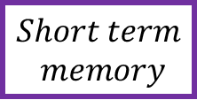

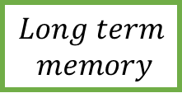






$$Long term$$
$$memory$$
$$×$$
$$sum$$
$$×$$
$$tanh$$
$$σ$$
$$σ$$
$$tanh$$
$$σ$$
$$×$$
$$sum$$
$$sum$$
$$sum$$
$$sum$$
$$Short term$$
$$memory$$
$$Input$$

Slide 9




































$$2$$
$$×$$
$$1.99$$
$$sum$$
$$2.96$$
$$×$$
$$tanh$$
$$0.997$$
$$1.0$$
$$0.97$$
$$0.99$$
$$σ$$
$$σ$$
$$tanh$$
$$σ$$
$$0.99$$
$$×$$
$$+1.62$$
$$+0.62$$
$$+ (−0.32)$$
$$+ (0.59)$$
$$sum$$
$$sum$$
$$sum$$
$$sum$$
$$0.98$$
$$×2.70$$
$$×2.00$$
$$×1.41$$
$$×4.38$$
$$1$$
$$×1.63$$
$$×1.65$$
$$×0.94$$
$$×(−0.19)$$
$$1$$

Slide 10
Step 1: Decide what to keep/forget from last cell state
CCDEPLRL

Slide 11



$$2$$
$$×$$
$$1.99$$
Percentage of long term to remember
$$0.997$$
$$σ$$
$$+1.62$$
$$sum$$
$$×2.70$$
$$1$$
$$×1.63$$
$$1$$

Slide 12
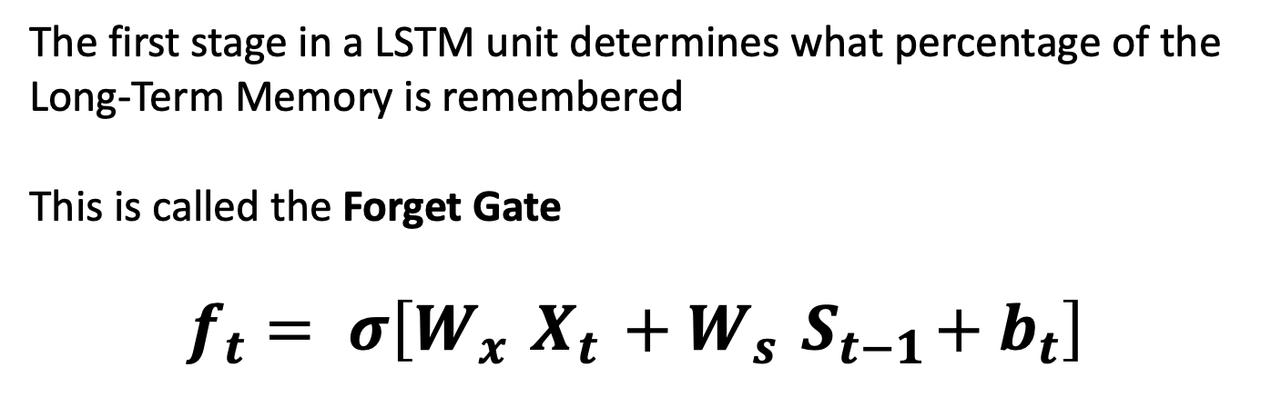
$$2$$
$$×$$
$$1.99$$
Percentage of long term to remember
$$0.997$$
$$σ$$
The first stage in a LSTM unit determines what percentage of the Long-Term Memory is remembered
This is called the Forget Gate
$$f_{t}= σ\left[W_{x}{ X}_{t} +W_{s}{ S}_{t−1}+b_{t}\right]$$
$$+1.62$$
$$sum$$
$$×2.70$$
$$1$$
$$×1.63$$
$$1$$

Slide 13
Step 2: Decide what to keep/forget from candidate cell state and create new cell state
CCDEPLRL

Slide 14
$$2$$
$$×$$
$$1.99$$
$$sum$$
$$2.96$$
$$×$$
$$0.997$$
$$1.0$$
$$0.97$$
$$σ$$
$$σ$$
$$tanh$$
$$+1.62$$
$$+0.62$$
$$+ (−0.32)$$
$$sum$$
$$sum$$
$$sum$$
$$×2.70$$
$$×2.00$$
$$×1.41$$
$$1$$
$$×1.63$$
$$×1.65$$
$$×0.94$$
$$1$$

Slide 15












$$2$$
$$×$$
$$1.99$$
$$sum$$
$$2.96$$
$$×$$
$$0.997$$
$$1.0$$
$$0.97$$
$$σ$$
This part of the LSTM unit determines how we should update the long term memory
This is called the Input Gate
$$i_{t}= σ\left[W_{x}{ X}_{t} +W_{s}{ S}_{t−1}+b_{t}\right]$$
$$σ$$
$$tanh$$
$$+1.62$$
$$+0.62$$
$$+ (−0.32)$$
$$sum$$
$$sum$$
$$sum$$
$$×2.70$$
$$×2.00$$
$$×1.41$$
$$1$$
$$×1.63$$
$$×1.65$$
$$×0.94$$
Percentage of potential memory
to remember
Potential long term memory
$$1$$

Slide 16
Step 3: Decide what to use from new cell state for output
CCDEPLRL

Slide 17
$$2$$
$$×$$
$$1.99$$
$$sum$$
$$2.96$$
$$×$$
$$0.997$$
$$tanh$$
$$1.0$$
$$0.97$$
$$0.99$$
$$σ$$
$$σ$$
$$tanh$$
$$σ$$
$$0.99$$
$$×$$
$$+1.62$$
$$+0.62$$
$$+ (−0.32)$$
$$+ (0.59)$$
$$sum$$
$$sum$$
$$sum$$
$$sum$$
$$0.98$$
$$×2.70$$
$$×2.00$$
$$×1.41$$
$$×4.38$$
$$1$$
$$×1.63$$
$$×1.65$$
$$×0.94$$
$$×(−0.19)$$
$$1$$

Slide 18
$$2$$
$$×$$
$$1.99$$
$$sum$$
$$2.96$$
$$×$$
$$0.997$$
$$tanh$$
$$1.0$$
$$0.97$$
$$0.99$$
$$σ$$
$$σ$$
$$tanh$$
$$σ$$
$$0.99$$
$$×$$
$$+1.62$$
$$+0.62$$
$$+ (−0.32)$$
$$+ (0.59)$$
$$sum$$
$$sum$$
$$sum$$
$$sum$$
$$0.98$$
$$×2.70$$
$$×2.00$$
$$×1.41$$
$$×4.38$$
$$1$$
$$×1.63$$
$$×1.65$$
$$×0.94$$
$$×(−0.19)$$
$$1$$
Percentage of potential memory
to remember
Potential short-term memory

Slide 19

$$2$$
$$×$$
$$1.99$$
$$sum$$
$$2.96$$
Because the new short term-memory is the output of this entire LSTM unit
This is called the Output Gate
$$O_{t}= σ\left[W_{x}{ X}_{t} +W_{s}{ S}_{t−1}+b_{t}\right]$$
$$S_{t}= O_{t} tanh\left[C_{t}\right]$$
$$tanh$$
$$0.99$$
$$σ$$
$$0.99$$
$$×$$
$$+ (0.59)$$
$$sum$$
$$0.98$$
New Short term Memory
$$×4.38$$
$$1$$
$$×1.63$$
$$×1.65$$
$$×0.94$$
$$×(−0.19)$$
$$1$$
Percentage of potential memory
to remember
Potential short-term memory

Slide 20
$$2$$
$$×$$
$$1.99$$
$$sum$$
$$2.96$$
$$×$$
$$tanh$$
$$0.997$$
$$1.0$$
$$0.97$$
$$0.99$$
$$σ$$
$$σ$$
$$tanh$$
$$σ$$
$$0.99$$
$$×$$
$$+1.62$$
$$+0.62$$
$$+ (−0.32)$$
$$+ (0.59)$$
$$sum$$
$$sum$$
$$sum$$
$$sum$$
$$0.98$$
$$×2.70$$
$$×2.00$$
$$×1.41$$
$$×4.38$$
$$1$$
$$×1.63$$
$$×1.65$$
$$×0.94$$
$$×(−0.19)$$
$$1$$

Slide 21
References
https://neptune.ai/blog/comprehensive-guide-to-transformers
https://www.simplilearn.com/tutorials/deep-learning-tutorial/rnn

